Slide 1

INTRODUCTION OF DOCKER ,KUBERNETES AND WEBASSEMBLY

Slide 2
What is the docker ?
Docker is a platform for developing, shipping, and running applications in containers.
Containers are lightweight, portable, and ensure consistent environments across different stages of development.
Through Docker we can create the image of the application and can run it.

Slide 3
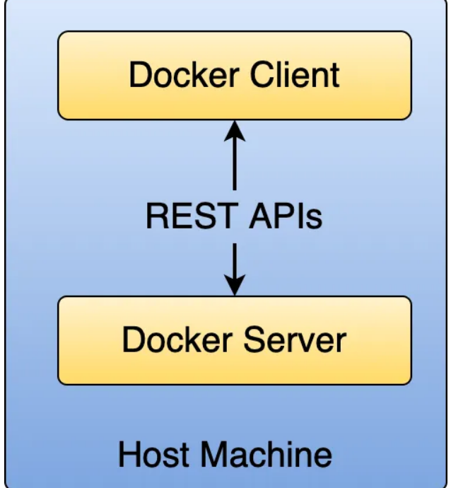
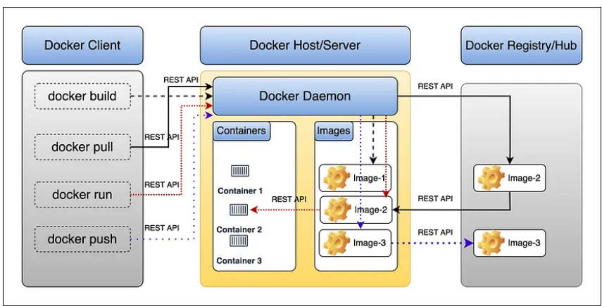
Architecture of Docker

Slide 4
Continue....
The Docker daemon (dockerd) listens for Docker API requests (docker build, docker run, docker push, docker pull, etc).
It Manages Docker objects such as images, containers, networks, and volumes.
When we use commands such as docker run, the client sends this command to the dockerd, which carries them out and processes it.
Internally the docker command uses the Docker REST APIs.

Slide 5
Docker improves the..
Environment Consistency
Isolation
Resource Efficiency
Portability
Scalability

Slide 6
Important commands of Docker
Building an Image: docker build -t <image_name>
Running a Container: docker run -d -p <host_port>:<container_port> <image_name>
Listing Containers: docker ps
Stopping a Container: docker stop <container_id>
Removing a Container: docker rm <container_id>
Viewing Logs: docker logs <container_id>

Slide 7
What is Kubernetes ?
Kubernetes is an open-source platform for managing containerized applications.
Kubernetes, often abbreviated as K8s, is a platform that helps manage containerized applications in various environments, ensuring they run smoothly.
Through this we can do scaling .

Slide 8
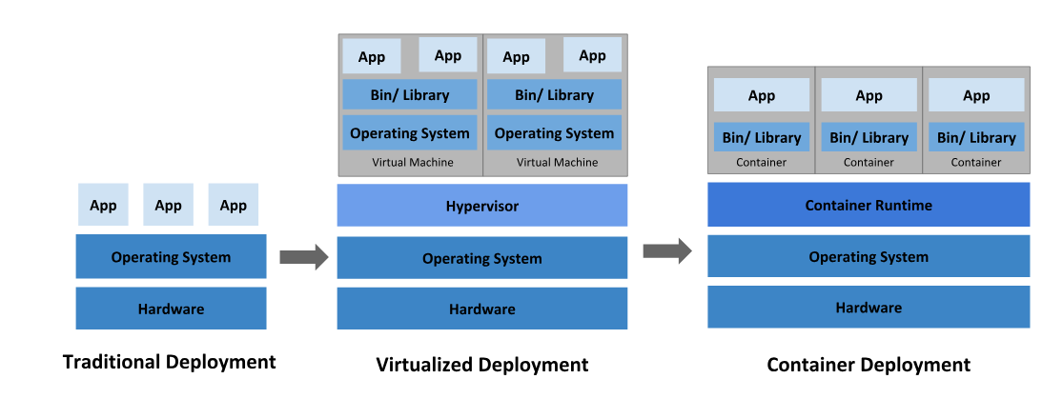
Why Kubernetes is important.

Slide 9
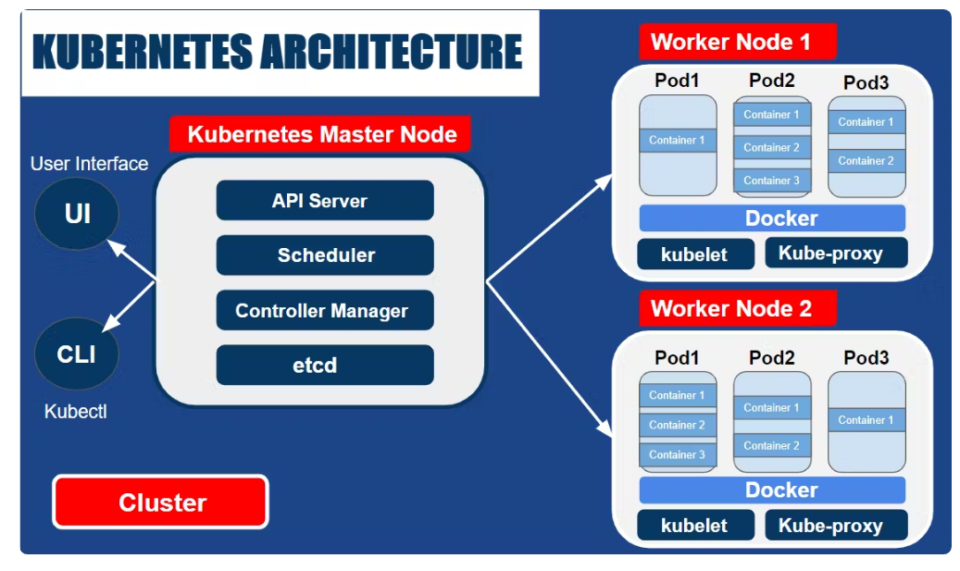
Architecture of Kubernetes

Slide 10
components
Master Node: The master node is the control plane of Kubernetes.
It makes global decisions about the cluster (like scheduling), and it detects and responds to cluster events.
Worker Nodes : Worker nodes are the machines where our applications run
It contains pod,container,kubelet and kubeproxy

Slide 11

Component of Master-Node
API Server
ETCD
Scheduler
Controller Manager

Slide 12

Components OF Worker- Node
Kubelet
Kube-proxy
Container runtime
Pods

Slide 13
Basic Command of Kubernetes
Create a Deployment: kubectl create deployment <name> --image=<image>
Expose a Deployment: kubectl expose deployment <name> --type=<type> --port=<port>
Scale a Deployment: kubectl scale deployment <name> --replicas=<number>
Get Pods: kubectl get pods
Get Services: kubectl get services

Slide 14

Kubernetes and Docker
Kubernetes and Docker are different yet complementary technologies for running containerized applications.
Through Docker we can put everything required for application in a box and for managing and deploying these boxes we required Kubernetes
So Kubernetes is a container management tool

Slide 15
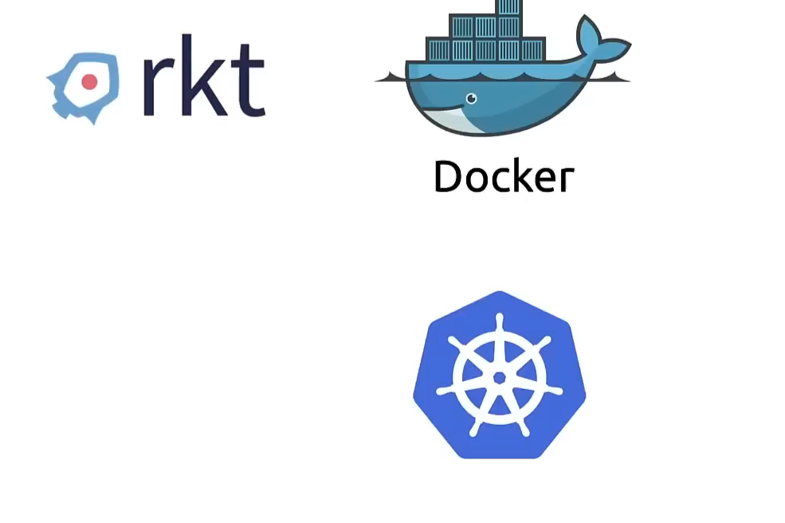
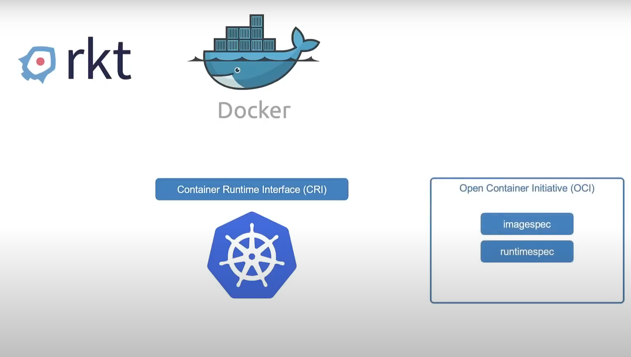
History of Docker and Kubernetes

Slide 16
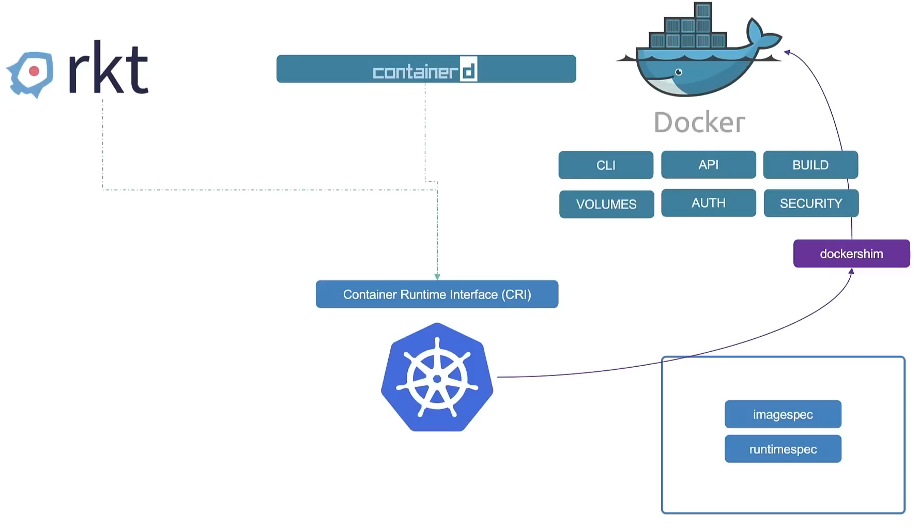
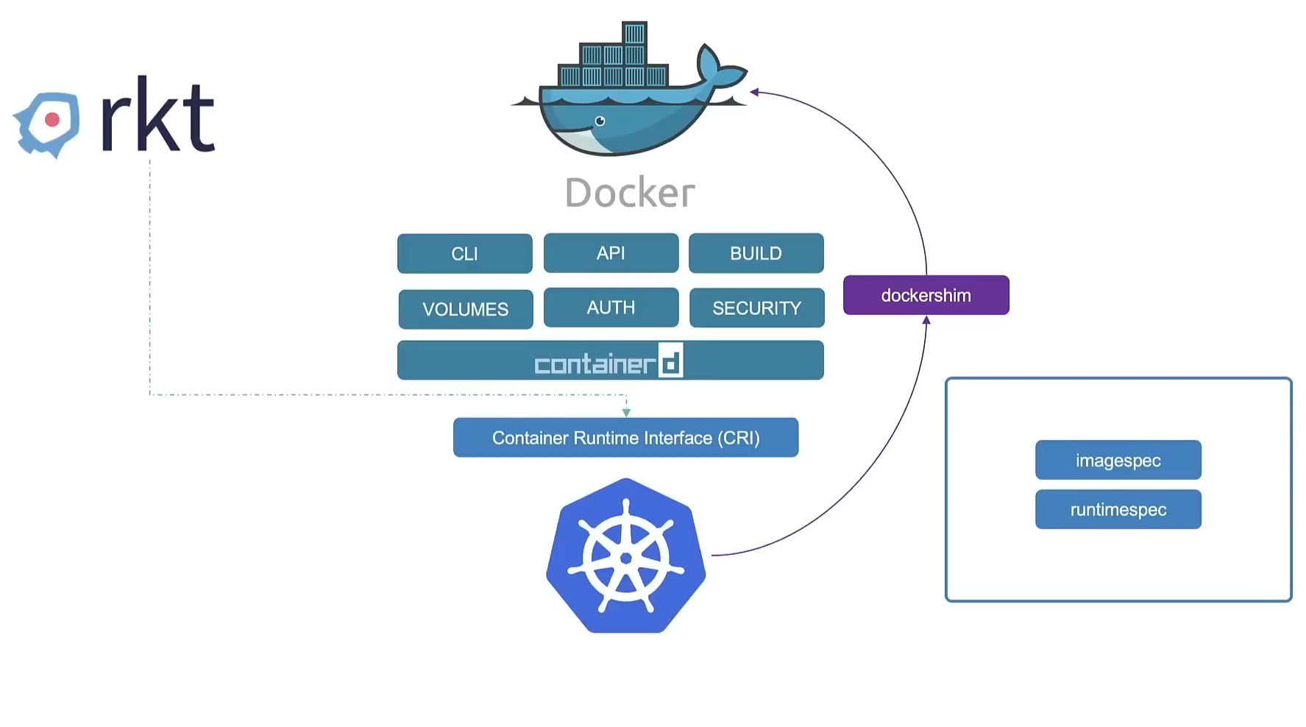
Continue...

Slide 17
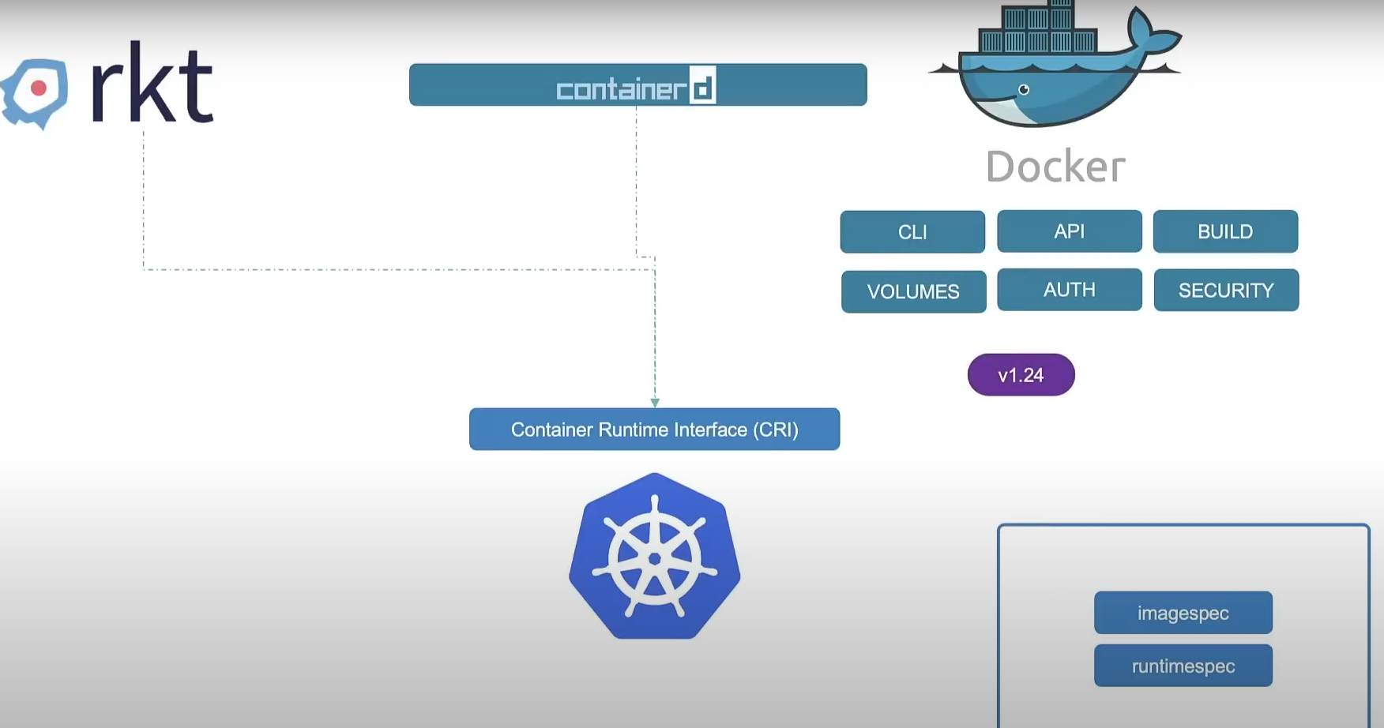
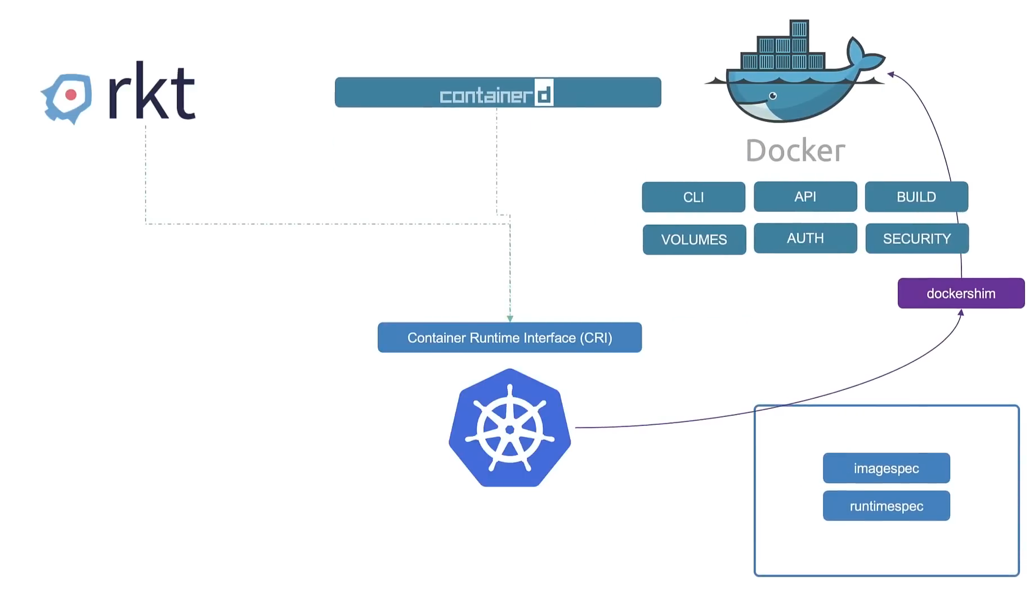
Continue...

Slide 18
What is Container d ?
container-d devloped by the Docker
It is a high-level run time .
In March 2017, Docker pulled its core container runtime into a standalone project called containerd and donated it to the Cloud Native Computing Foundation (CNCF).
Containerd runtime is the engine that runs and manages the components required to runnig containers
It uses tools like runc for low-level runtime and shim for managing and running the conatainer.

Slide 19
Continue..
runc is a CLI tool for spawning and running containers according to the OCI specification.
shim is a piece of software that resides in between a container manager (containerd, cri-o, podman) and a low-level container runtime (runc, crun) solving the integration problem of these counterparts.

Slide 20
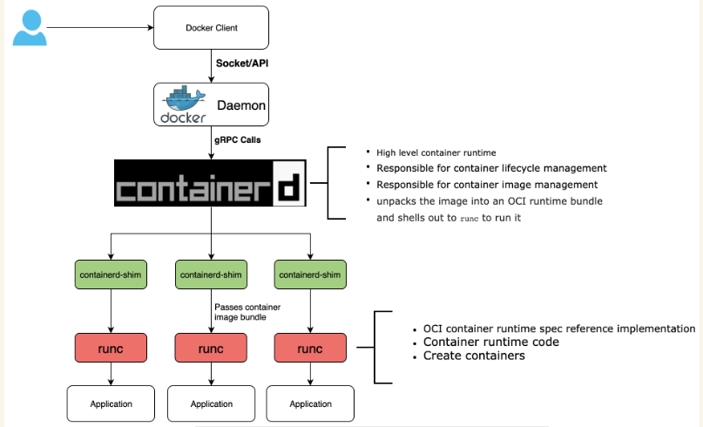
How container-d run with docker

Slide 21
Docker without Kubernetes
Kubernetes is removing support for Docker as a container runtime
it relies on another piece of software called a container runtime.
Kubernetes works with all container runtimes that implement a standard known as the Container Runtime Interface (CRI).
Docker is not actually a container runtime! It’s actually a collection of tools that sits on top of a container runtime called containerd.
That’s why kubernetes directly interact with conatinerd
Docker is just a middle-man between Kubernetes and containerd.

Slide 22
ContainerD with Kubernates
Kubernetes can use tools like CRI-O and crictl to interact with containerd via Container Runtime Interface (CRI)
CRI-O: CRI-O is like a container engine, a program that helps run containers
It works with any OCI-compliant runtime (tools that follow the Open Container Initiative standards like containerd). Essentially, it helps Kubernetes run containers in a standard way

Slide 23
Continue
Crictl:Crictl is a tool you can use to interact with CRI-O and other similar container engines
It lets you test, debug, and check how containers are running. If there's a problem with Kubernetes or how CRI-O is set up, crictl can help you find and fix the issue.
So now whole scenario is ConatinerD can run without the Docker because it is already a container run time engine and it support both OCI and CRI interface

Slide 24
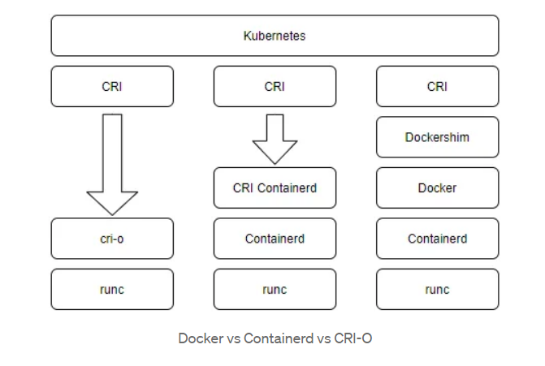
Comparison between Docker, Containerd and CRI-O

Slide 25
Overview of WebAssembly
WebAssembly is a type of code that can be run in modern web browsers.
WebAssembly (Wasm) is a low-level, binary code format designed for execution on a stack-based virtual machine.
it Intended as a compilation target for high-level languages like C, C++, and Rust, rather than being written by hand.
it provides a way to run code written in multiple languages on the web at near-native speed.

Slide 26
WebAssembly goals
Be fast, efficient, and portable
Be readable and debuggable
Keep secure.
Don't break the web

Slide 27
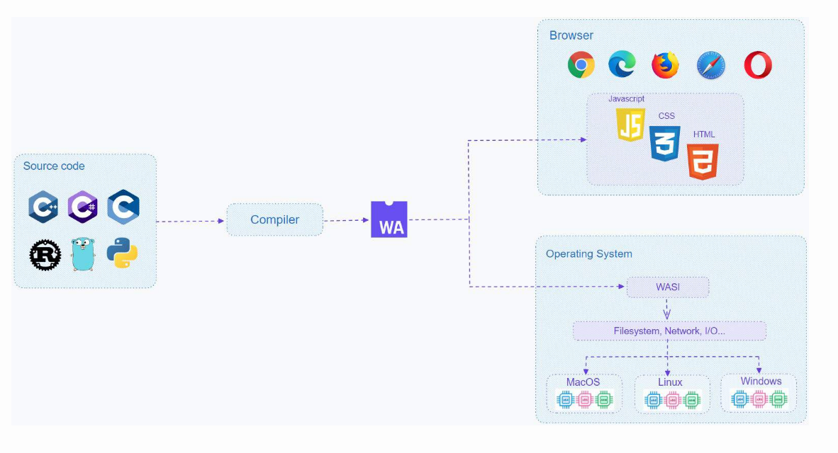
Continue...

Slide 28
Run Wasm modules in container runtimes that have Wasm support
Low-level Container Runtime: This refers to OCI-compliant implementations that can receive a runnable filesystem (rootfs) and a configuration file.
Low-level container runtimes directly manage and run containers, such as runc, crun, youki, gvisor, and kata.
High-level Container Runtime: This is responsible for the transport and management of container images, unpacking the image, and passing it off to the low-level runtime to run the container.like ConatainerD and CRI-O.
We can enable Wasm support in both low-level and high-level container runtimes

Slide 29
continue
When running Wasm modules through high-level container runtimes, both CRI-O and containerd are great options.
There are two approaches the run wasm module.
One is that the high-level runtime still depends on low-level runtimes, invoking the low-level runtime to execute the Wasm module.
The other approach is that containerd has a subproject called runwasi, which enables developing a containerd-wasm-shim that interacts directly with the Wasm runtime such as WasmEdge and Wasmtime

Slide 30
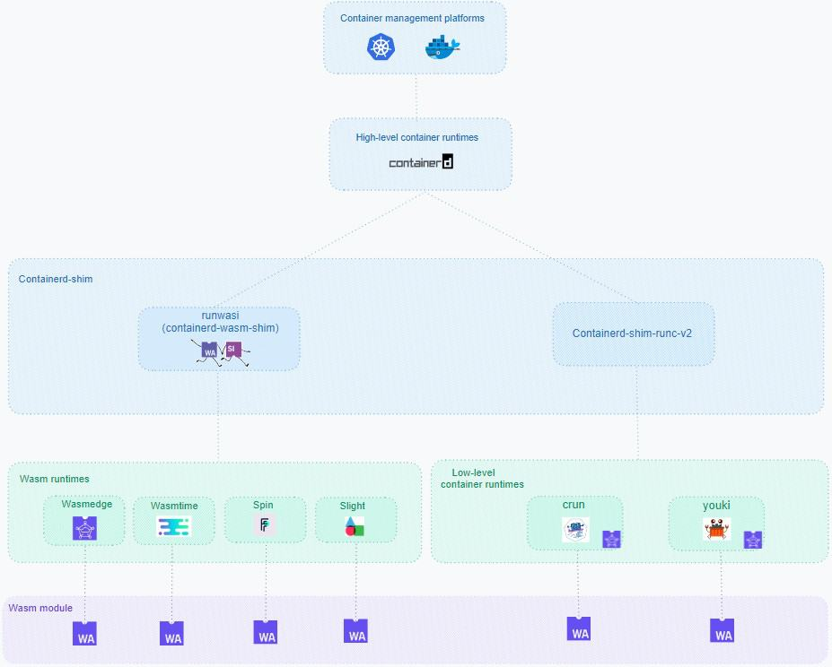

Slide 31
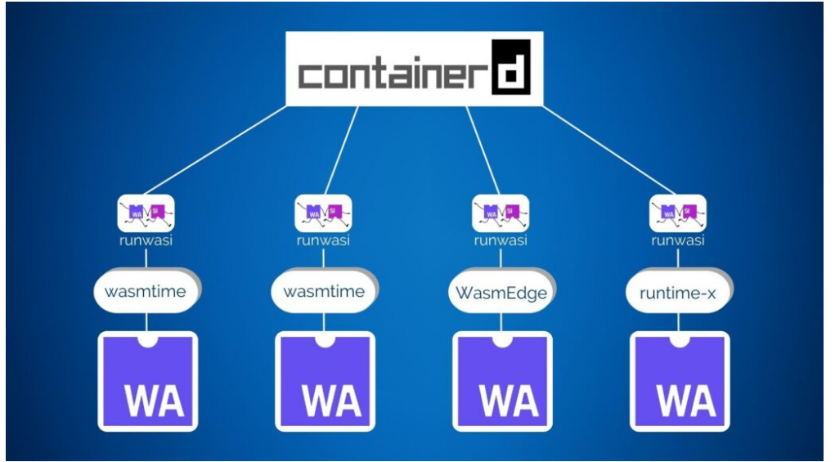
By using ConatainerD

Slide 32

THANK YOU

